Slide 1
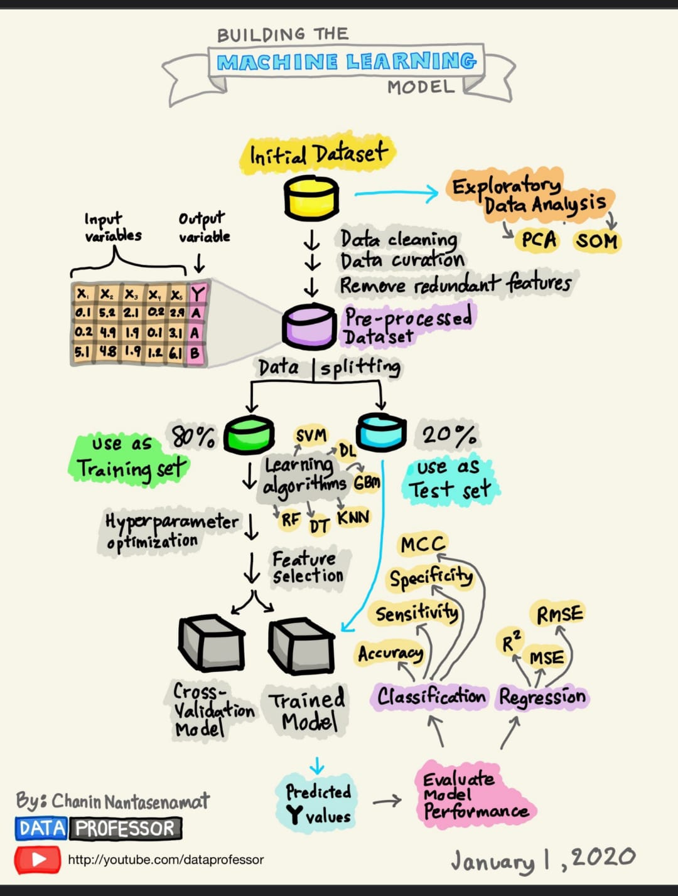
CATCH ON TO
Machine Learning

Slide 2
n
What is ML ?
ML is an area of AI with
the sole purpose that a machine can learn & adapt itself to new data without any external input or human intervention.

Slide 3
n
How ML is Associated ?
AI
ML
DATA SCIENCE
DEEP LEARNING

Slide 4

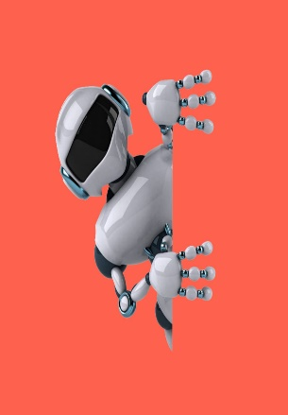
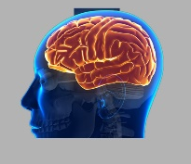
How ML differ from AI?
This template is exclusive designed by Fei. er. creative, and copyrights belongs to Bao. tu. Internet.
AI is the technology using which we can create intelligent system that can simulate human intelligence ,
whereas ML is the subfield of AI , which enables machines to learn from past data or experiences.
AI
ML
.

Slide 5
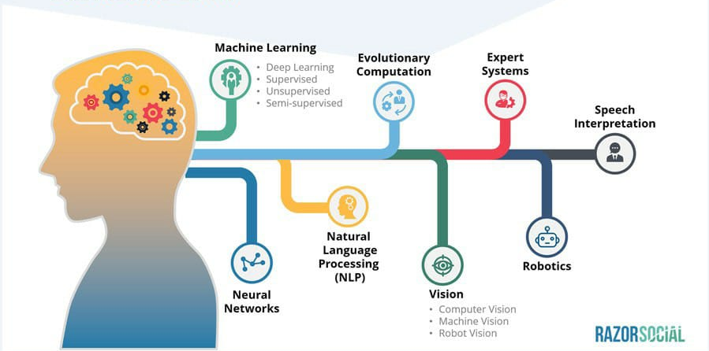
ML - A subset of AI
Courtesy: Razorsocial

Slide 6
For Instance:
MOVIE RECOMMENDATION SYSTEM
Arun watches 6 movies
Langauge
Genre
Run time
5 movies less than 2hrs
1 movie more than 2hrs
3 Tamil
2 Telugu
1 Hindi
4 action
2 comedy
Less than 2hrs
Tamil
Action
Recommend:
Tamil action movie with less than 2hrs

Slide 7
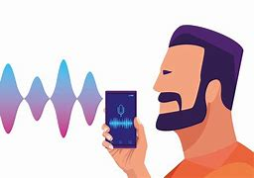
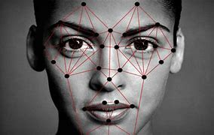
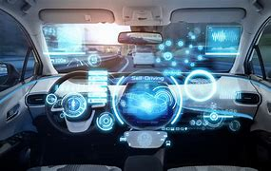
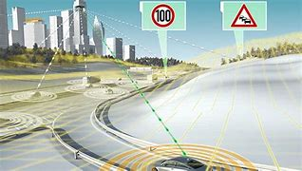
APPLICATONS:
Voice Recognition
Face Recognition
Self-driving cars
Traffic Prediction

Slide 8
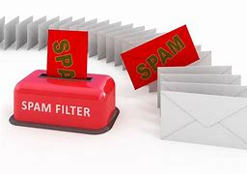
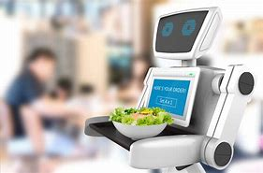
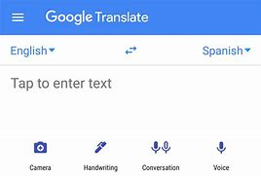
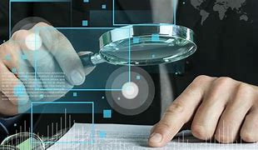
Spam filteration
Virtual assistant
Google translate
Fraud dection

Slide 9
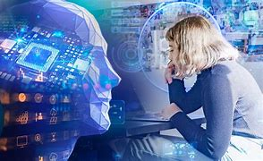
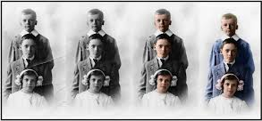
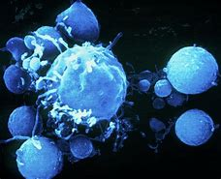
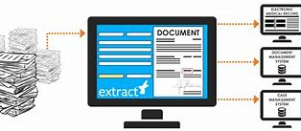
Pixal restoration
virtual personal assistant
identification cancer cell
document clarification

Slide 10
What Machine learning does ?
Traditional Programming
data
It build’s program to predict future with the previous output data using statistics.
Computer
output
program
Machine learning
data
program
output
Computer
“Predicting the future isn’t magic, It’s artificial intelligence
- Dave Water”

Slide 11
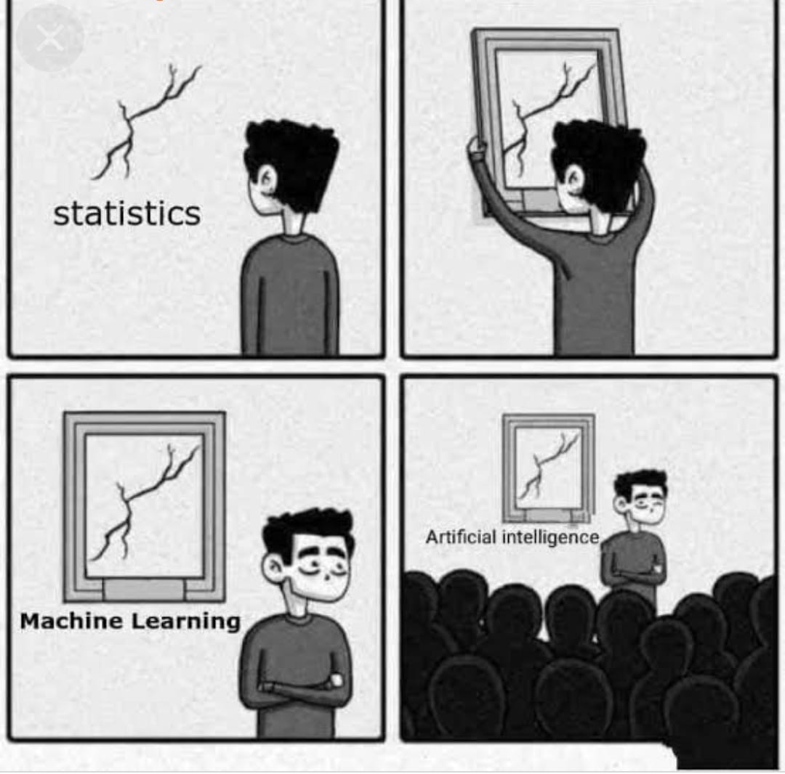
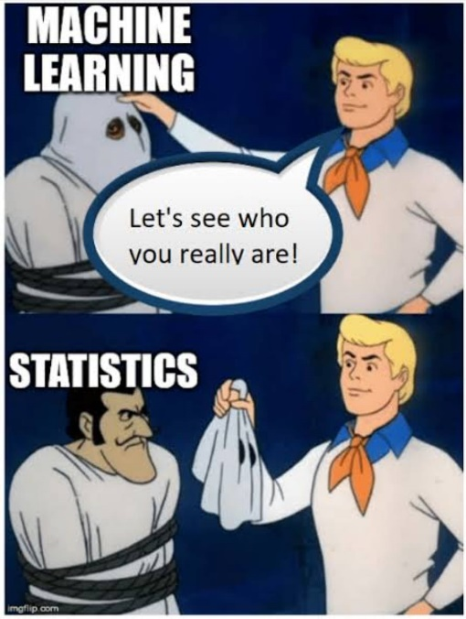
Is statistic used in ML ?
Yess!!!
Statistic is a core components of ML
COURTESY: Ceaul,UX collective

Slide 12
Machine Learning
Supervised learning
Unsupervised
learning
Reinforcement
learning
Regression
Classification
Clustering
Decision Making
Linear regression
Neural network regression
Support vector regression
Decision Tree regression
Lasso regression
Ridge Regression
Naïve bayes classifier
Decision tree
Support vector machines
Random forest
k- nearest neighbors
K- means clustering
Mean-shift clustering
DBSCAN clustering
Agglomerative hierarchical clustering
Gaussian mixture
Q- learning
R- learning
TD learning

Slide 13
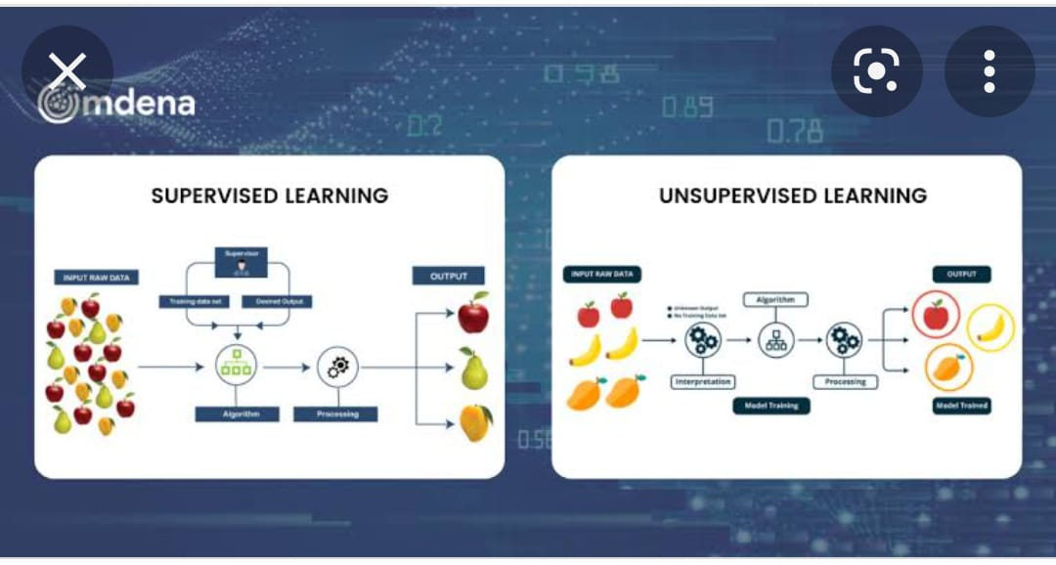
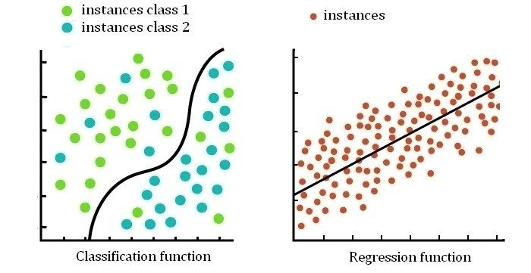
SUPERVISED VS UNSUPERVISED
Supervised machine learning relies on labelled input and output training data,
unsupervised learning processes unlabelled or raw data
COURTESY: Omdena

Slide 14
SUPERVISED :
REGRESSION VS CLASSIFICATION
Numerical data
It attempt to find the best fit line, which predicts the output more accurately.
Categorical data
Classification tries to find the decision boundary, which divides the dataset into different classes.
COURTESY: Researchgate

Slide 15
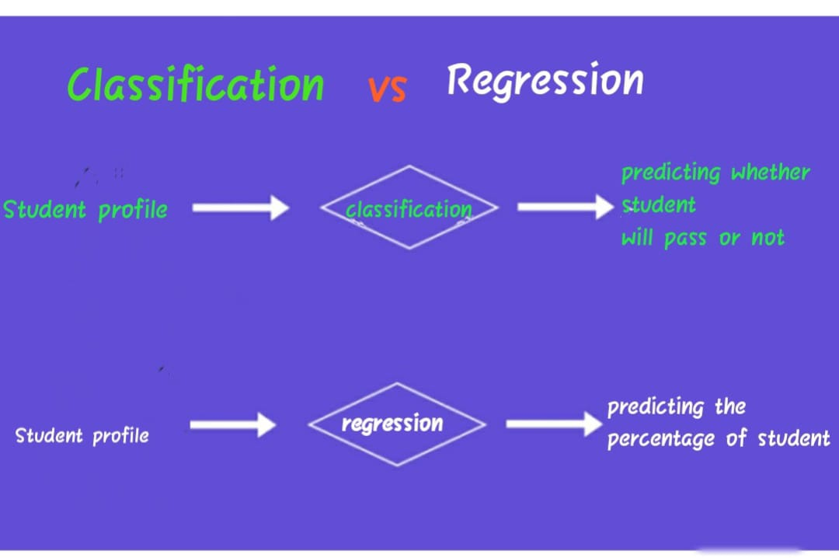
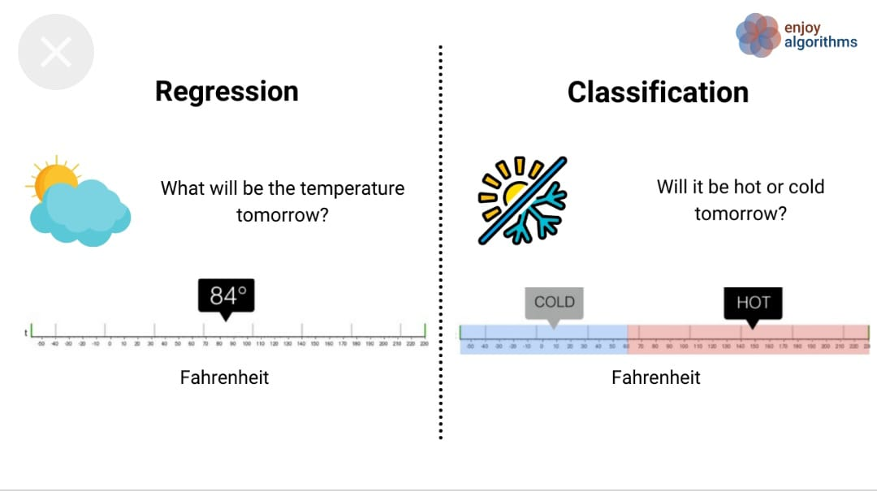
EXAMPLES
.
COURTESY: Enjoy algorithm

Slide 16
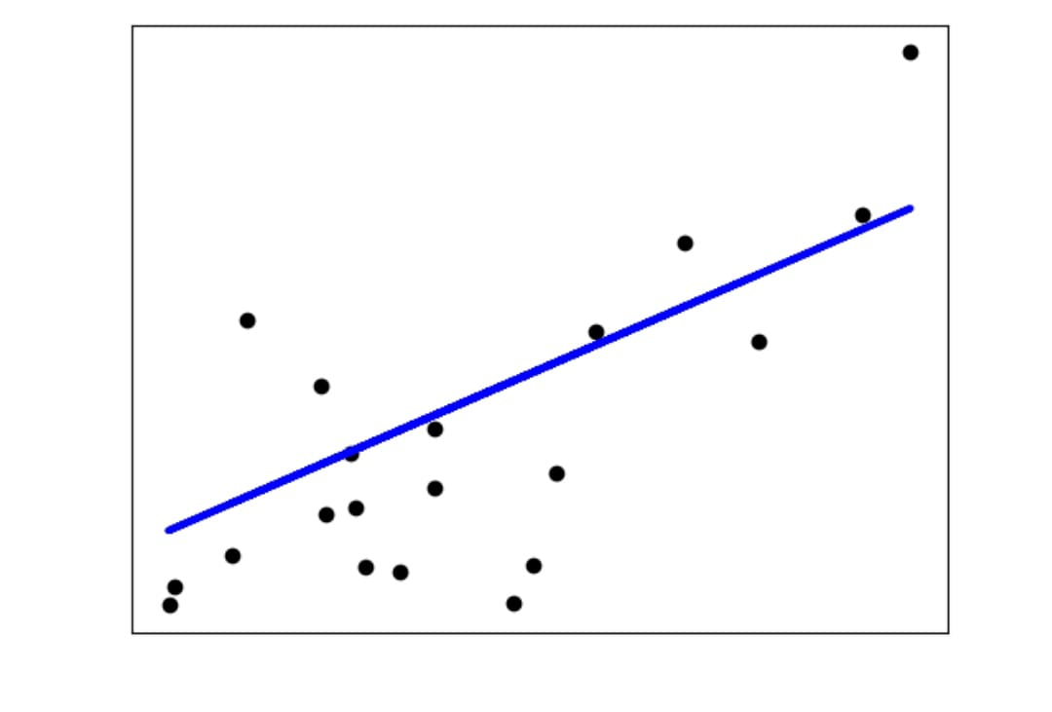
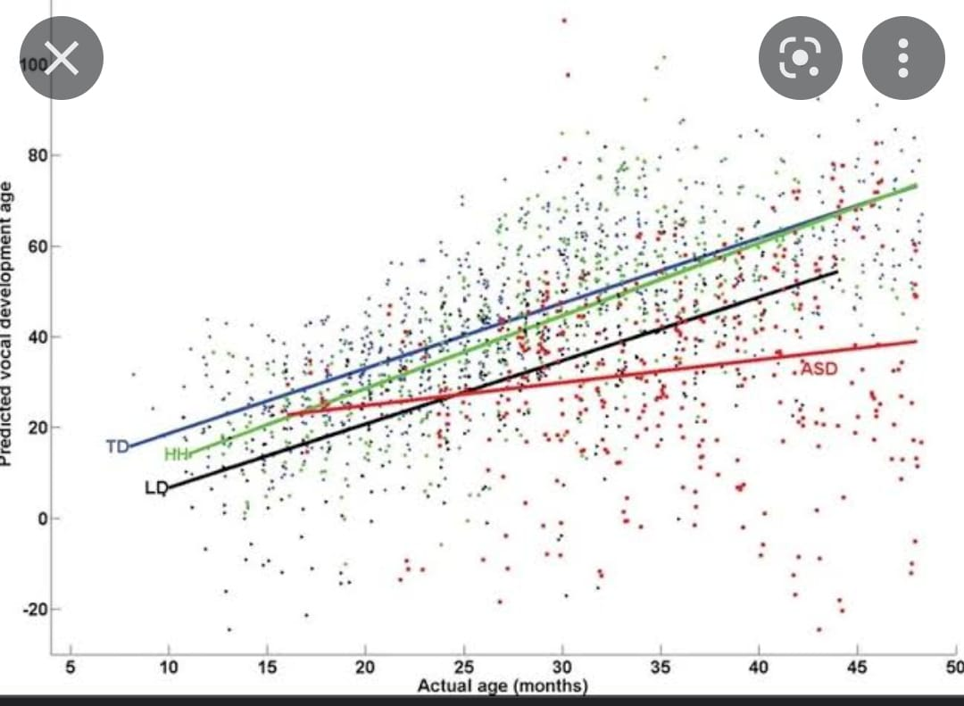
Regression:
Common algorithms :
Simple linear
Multiple linear
COURTESY: sciket learn,upgrad

Slide 17
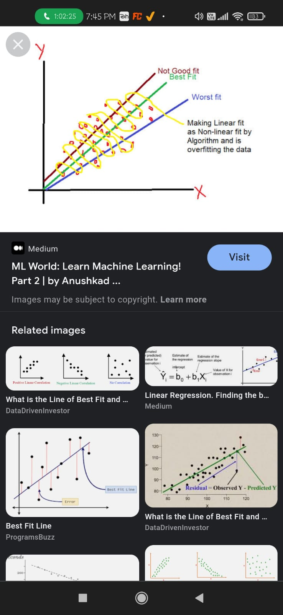
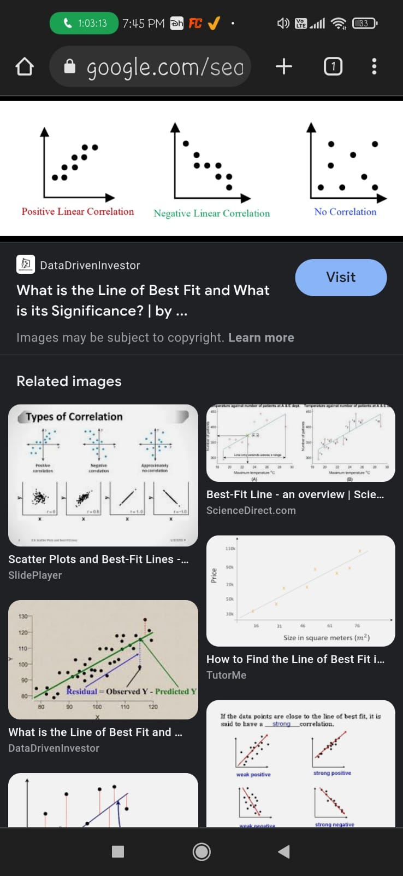
BEST FIT AND CORELATION
.
COURTESY: Anushkad,data driven investor

Slide 18
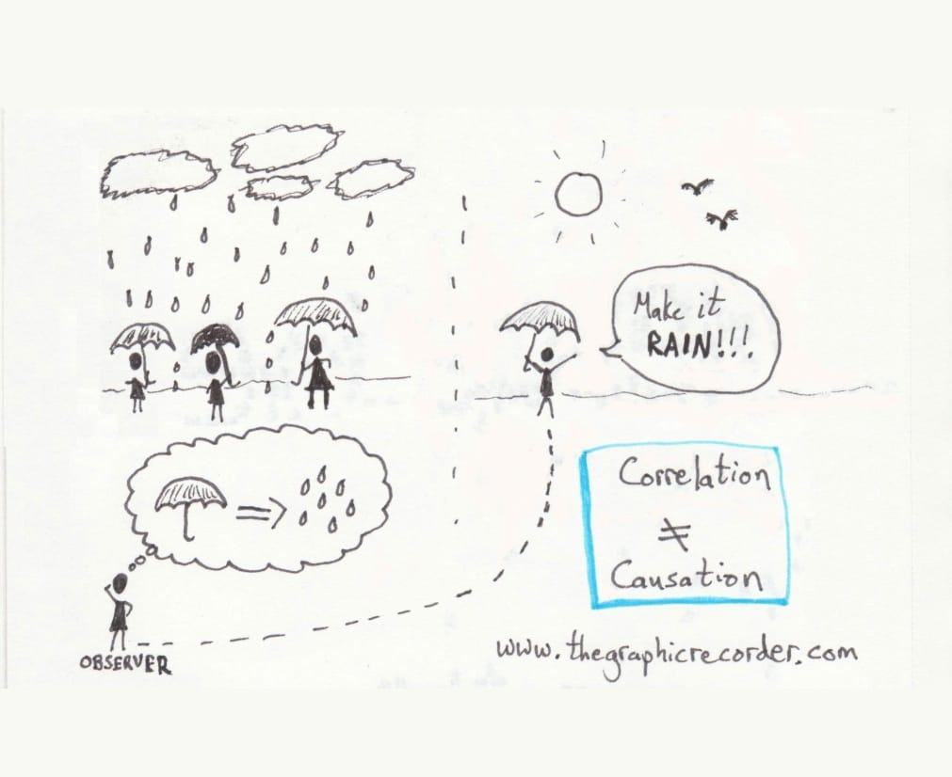
DEPENDENT AND INDEPEDENT
.
Independent variables are what we expect will influence dependent variables.
A Dependent variable is what happens as a result of the independent variable
COURTESY: thegraphicrecoder

Slide 19
EXAMPLE
.
Crop yield(dependent variable)
Rainfall(independent variable)
CURTESY: sciket learn

Slide 20
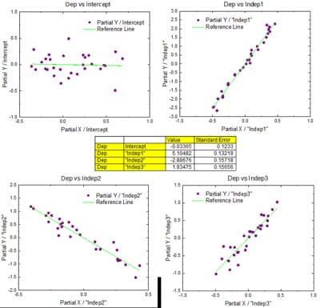
Multiple linear regression:
Linear regression with more than one independent variable which defines dependent variable.
COURTESY: origenlab

Slide 21
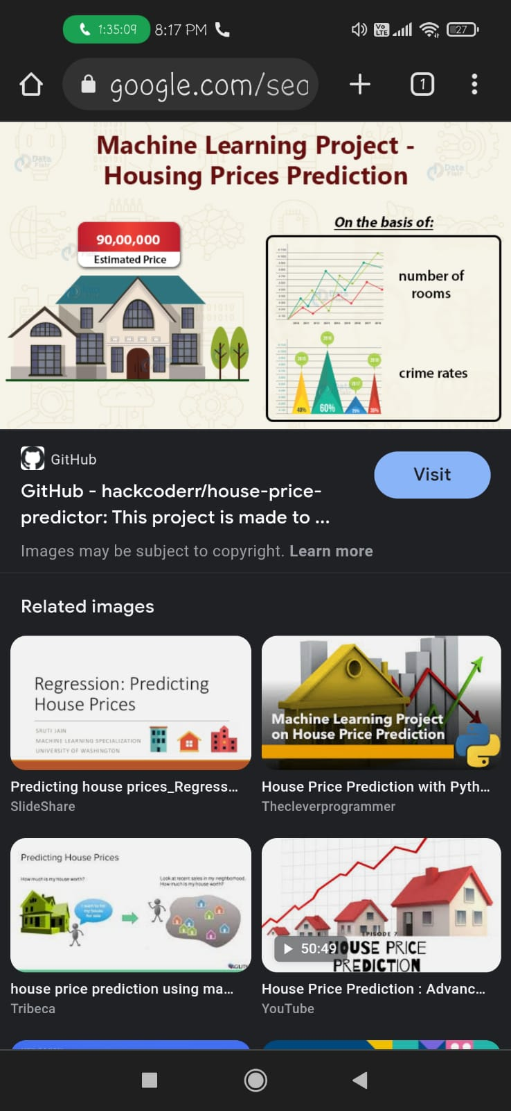
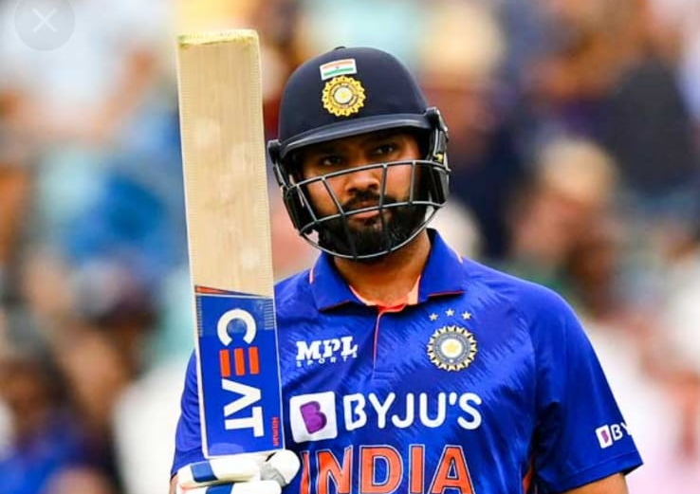
EXAMPLES
.
HOUSE PREDCTION
SCORE PREDCTION
COURTESY: github,sportstiger

Slide 22
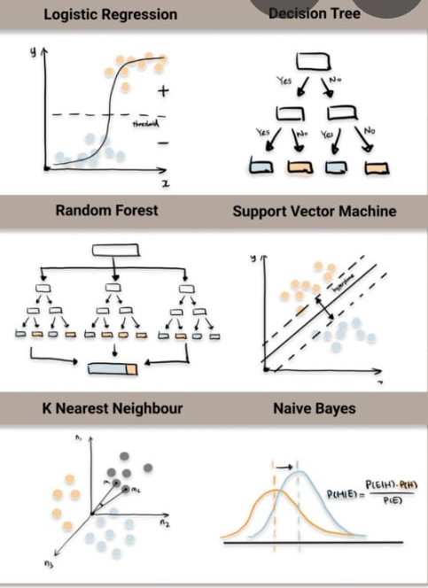
Classification:
Common algorithms :
Decision tree
Logistic regression
Random forest
Naïve bayes
COURTESY: towardsdatascience

Slide 23
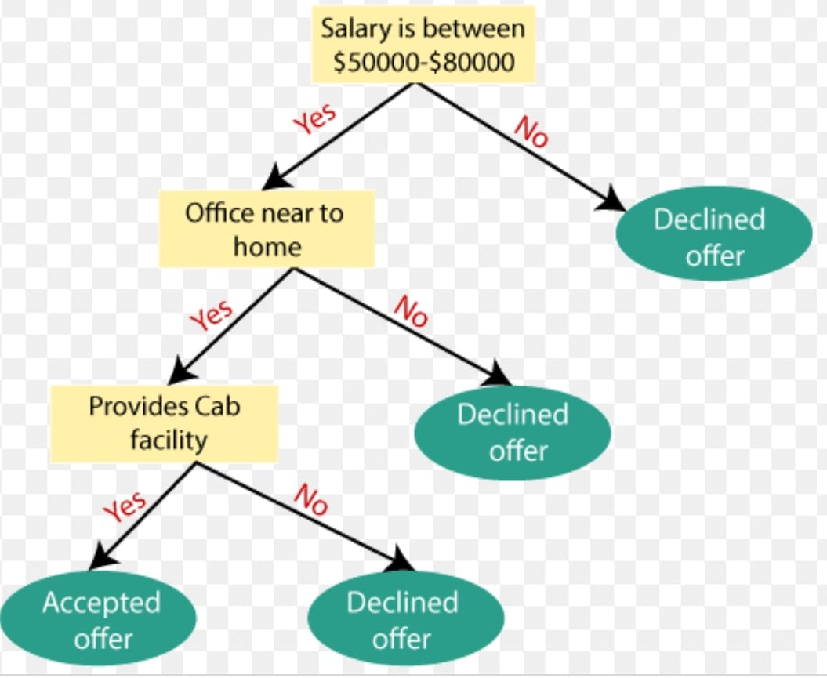
Decision tree:
A decision tree is a very specific type of probability tree that enables you to make a decision about some kind of process.
COURTESY: towardsdatascience

Slide 24
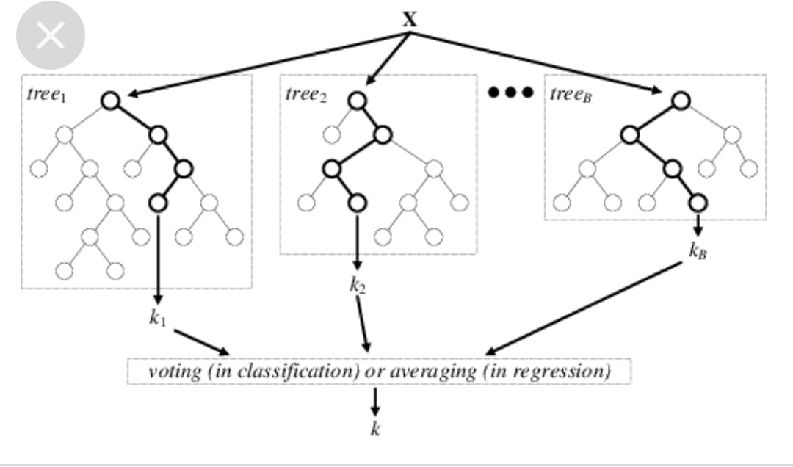
Random forest:
The random forest is a classification algorithm consisting of many decisions trees.
COURTESY: researchgate

Slide 25
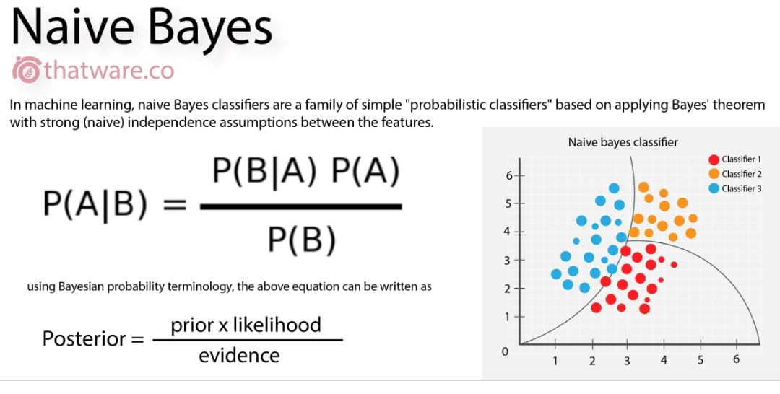
Naïve bayes:
Naive Bayes is a classification algorithm for binary (two-class) and multi-class classification problems.
COURTESY: thatware

Slide 26
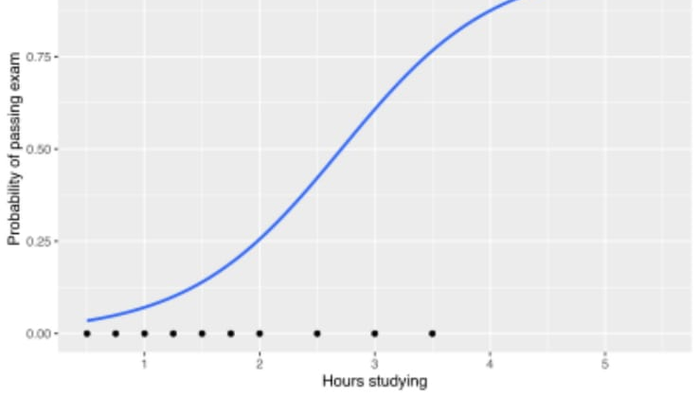
Logistic regression:
Logistic regression used to calculate or predict the probability of a binary (yes/no) event occurring.
COURTESY: thatware

Slide 27
USES OF SUPERVISED ML
Bioinformatics
Speech recognition
Object recognition
Traffic prediction
Email spam
Image classification

Slide 28
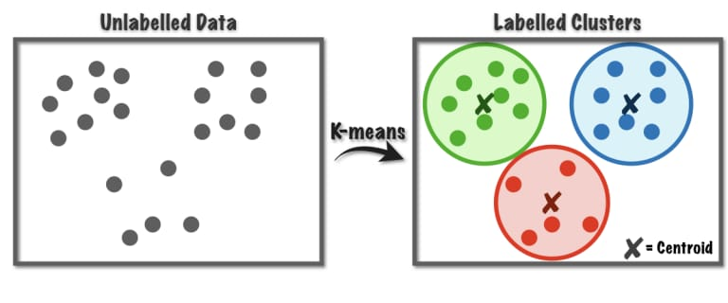
UNSUPERVISED ML:
CLUSTERING:
Common used algorithm:
K Means clustering
COURTESY: naukri

Slide 29
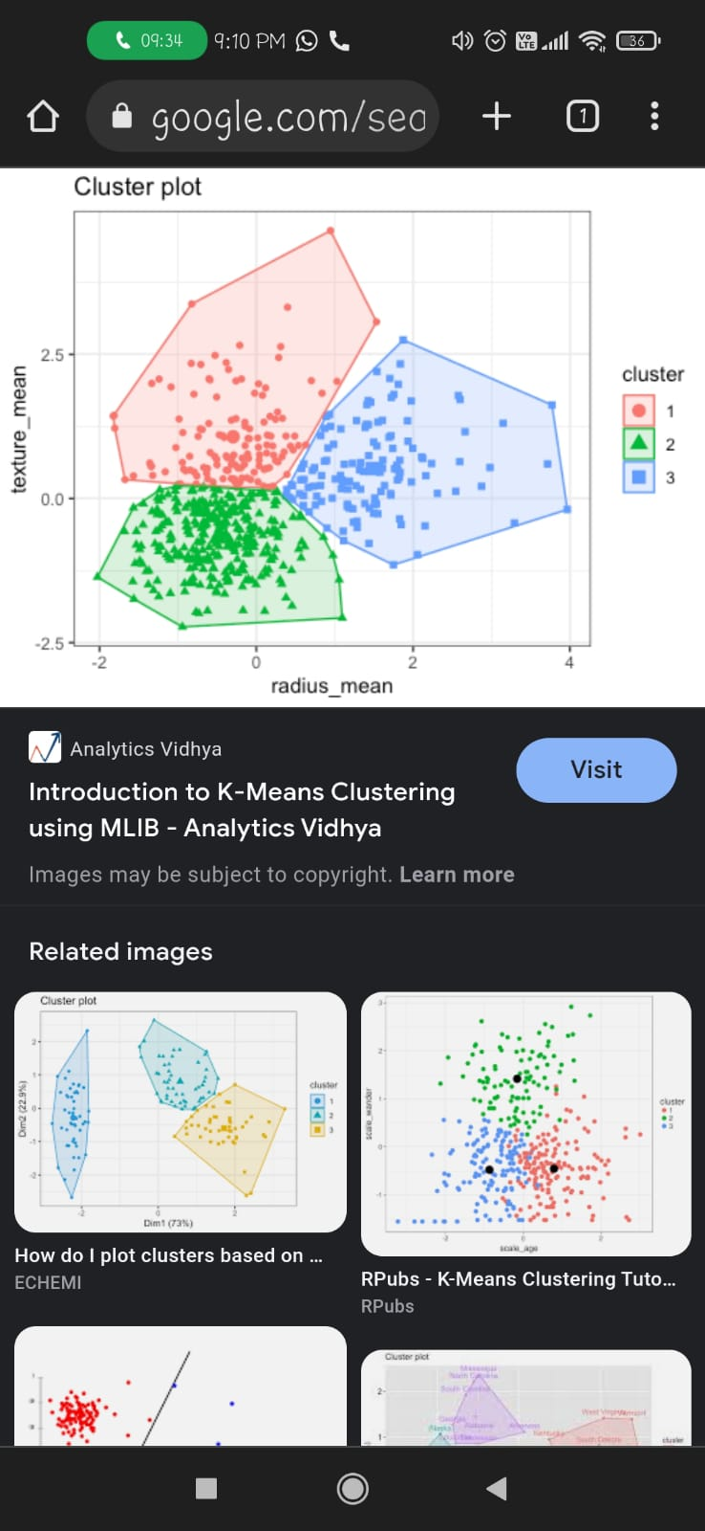
K – means clustering:
A cluster refers to a collection of data points aggregated together because of certain similarities.
K-means clustering is one of the simplest and popular unsupervised machine learning algorithms.
COURTESY: analytics vidhya

Slide 30
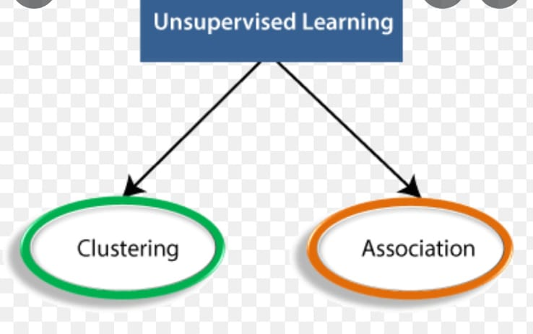
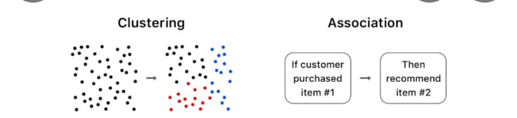
Association.
Add your text.
This template is exclusivtu. Internet.
This template is exclusive designed by Fei. er. creative, and copyrights belongs to Bao. tu. Internet.
Association rule learning is a kind of unsupervised learning technique that tests for the reliance of one data element on another data element and design appropriately so that it can be more cost-effective.

Slide 31
USES OF UNSUPERVISED ML
Anmoly dectation
Segmentation
Social network analysis
Identification cancer cell
In search engine

Slide 32
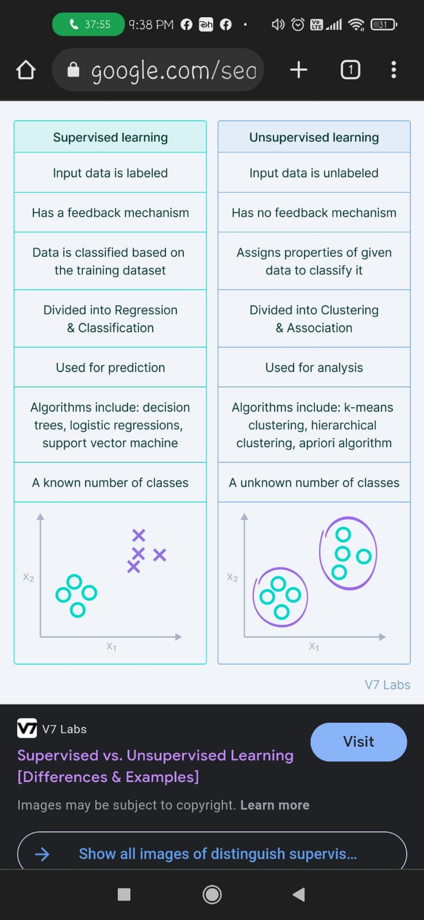
SUPERVISED VS UNSUPERVISED
,
COURTESY: v7lab

Slide 33
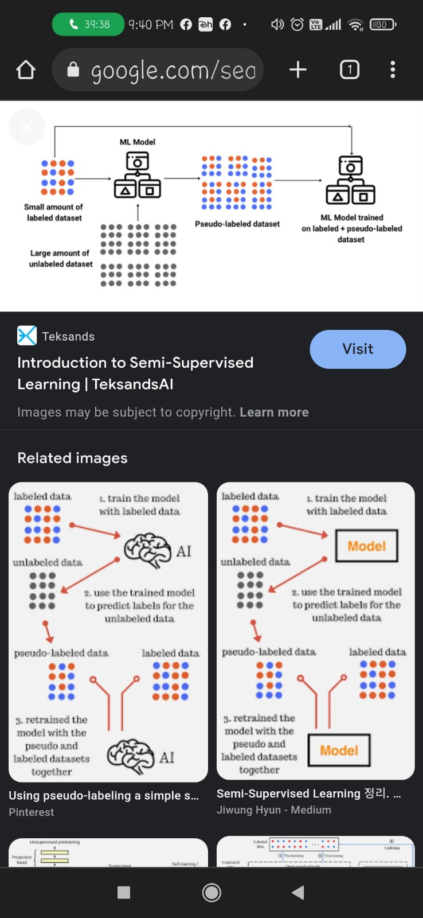
Semi- supervised:
semi-supervised learning is an approach to machine
learning that combines a small amount of labeled
data with a large amount of unlabeled data during
training. Semi-supervised learning falls between
unsupervised learning and supervised learning.
COURTESY: teksands

Slide 34
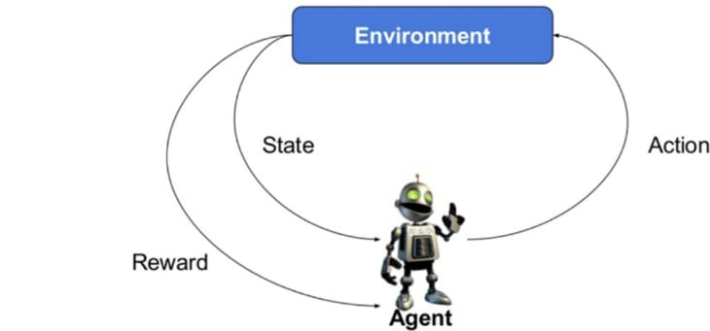
Reinforcement:
Reinforcement learning is a machine
learning training method based on
rewarding desired behaviors and/or
punishing undesired ones

Slide 35
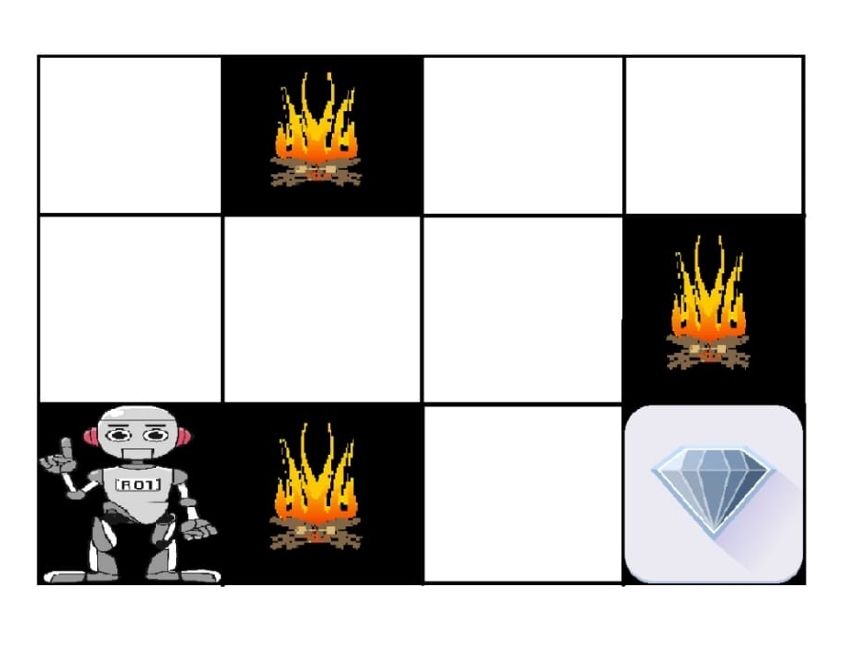
Example:
The above image shows the robot,
diamond, and fire. The goal of the
robot is to get the reward that is
the diamond and avoid the
hurdles that are fired. The robot learns
by trying all the possible paths and
then choosing the path which
gives him the reward with least hurdles.

Slide 36
USES OF REINFORCEMENT ML
Personalised chatbot respond
Self driving cars
Video recomendations

Slide 37
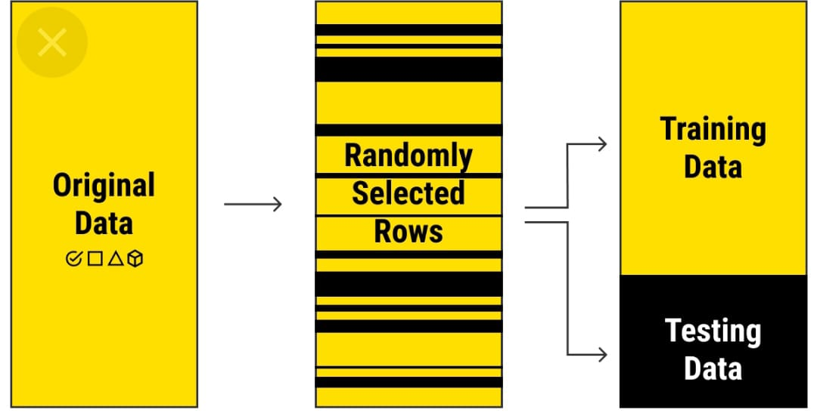
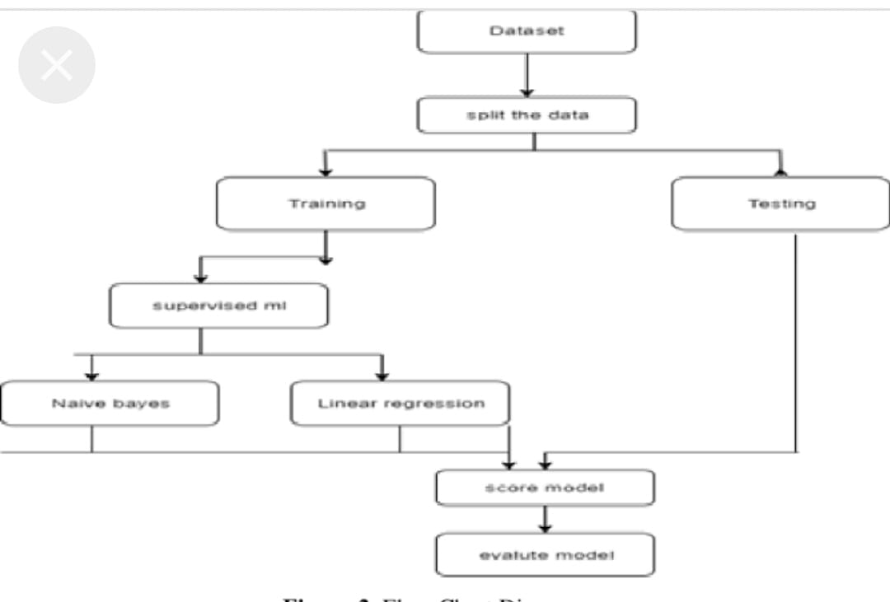
TRAINING AND TESTING:
A training set is implemented to build up a model, while a test set is to validate the model built. In the processes of training and testing there could be problems that you want to avoid.
COURESY: educba

Slide 38
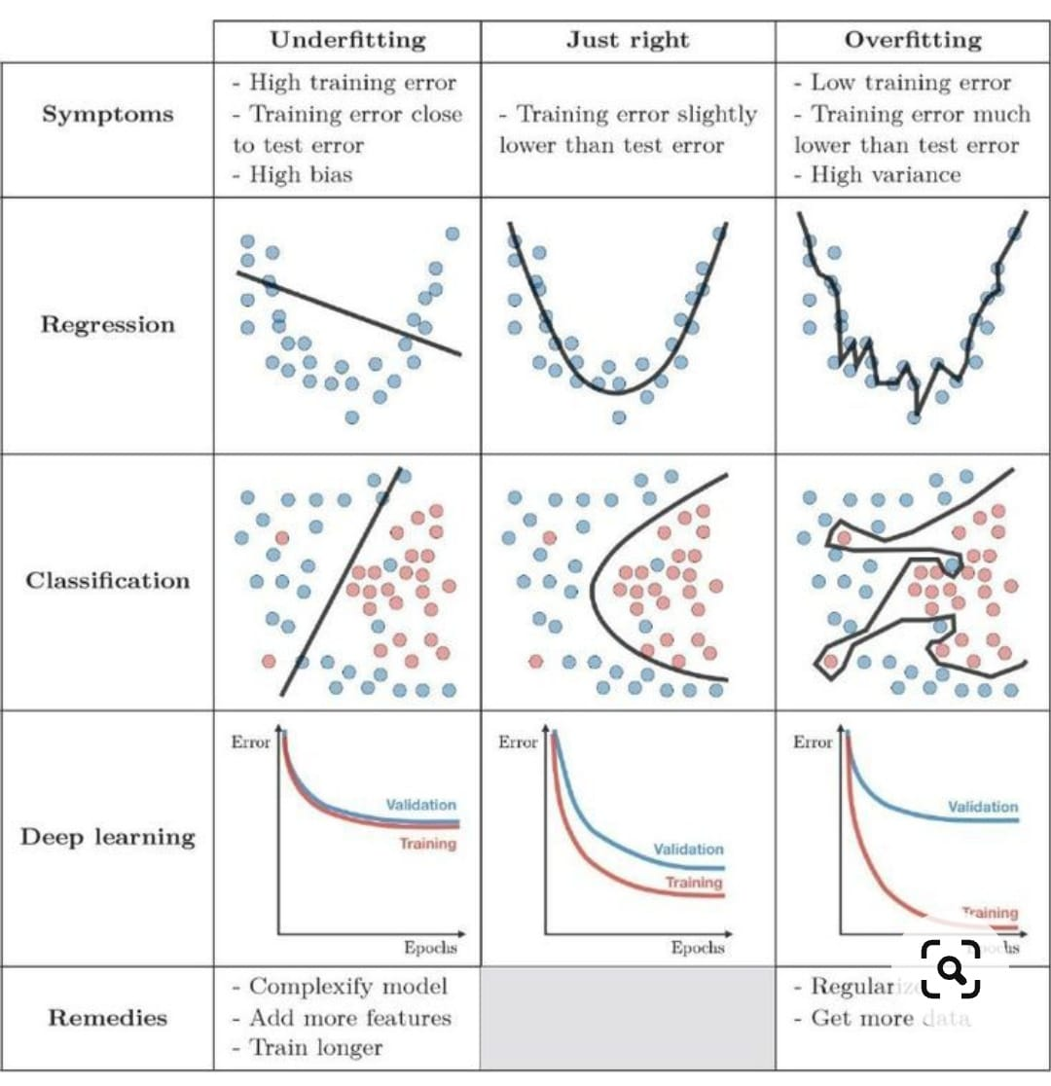
UNDERFIT AND OVERFIT:
COURESY: educba

Slide 39
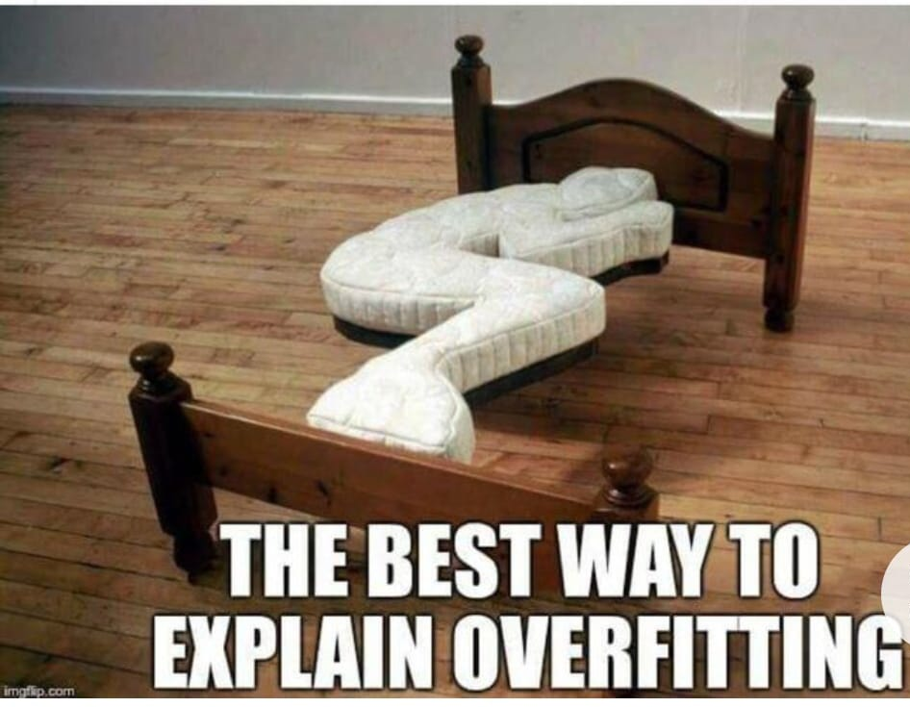
FUNNY EXAMPLE:
COURESY: YOUTBE- Planet dolan

Slide 40
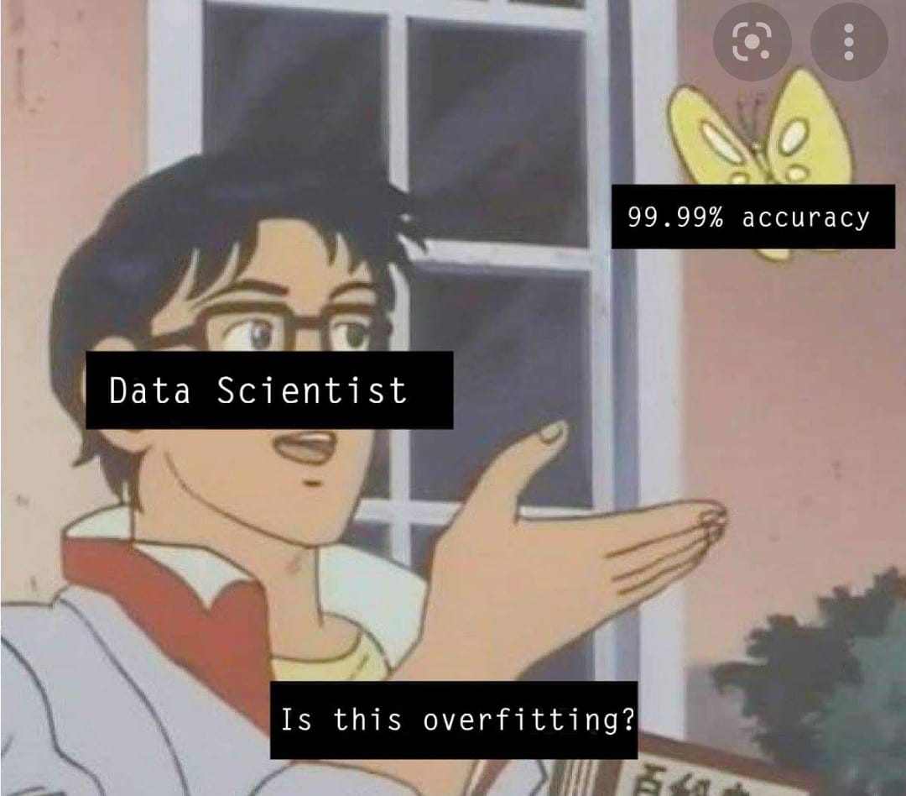
FUNNY EXAMPLE:
COURESY: YOUTBE- Planet dolan

Slide 41
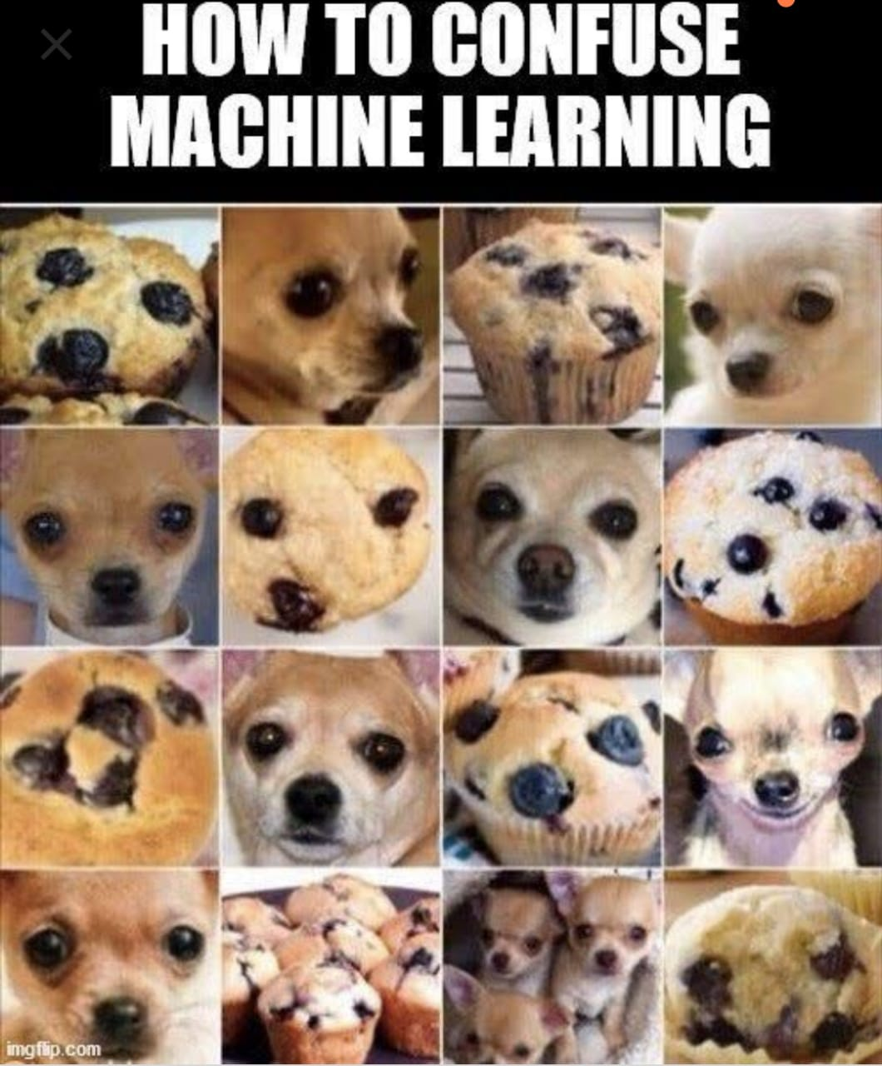
FUNNY EXAMPLES:
FIND THE DOG IMAGES?

Slide 42
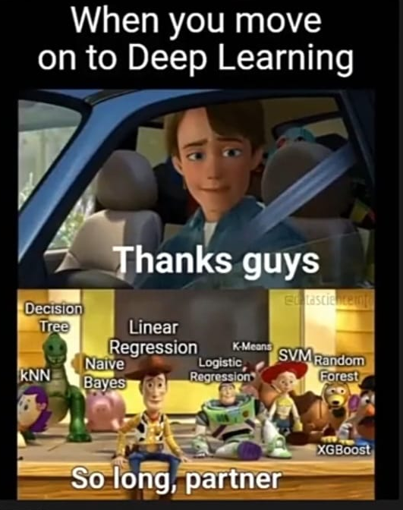
.

Slide 43

DEEP LEARNING
Deep learning is a type of machine learning based on artificial neural networks in which multiple layers of processing are used to extract progressively higher level features from data.

Slide 44
PROGRAMMIMG FOR ML
Python
R Programming
Javascript/Java
Julia

Slide 45

.

Slide 46

EXPLORATORY DATA ANALYSIS:
Unwanted data and unorganised data can disturbs the model and makes the model innefficient.
To overcome with EDA is done

Slide 47


.

Slide 48

FUTURE OF ML:
Internet of Things and Machine Automated machine
Improve Cybersecurity
Ethics in Artificial Intelligence
Automation of natural speech understanding process
General Adversarial Network
Few ShotOne Shot, & Zero-Shot Learning

Slide 49

TOP COMPANIES INVESTED IN
MACHNINE LEARNING:
1.Google – $3.9 billion
2. Amazon – $871 million
3. Apple – $786 million
4. Intel – $776 million
5. Microsoft – $690 million
6. Uber – $680 million
7. Twitter – $629 million
8. AOL – $191.7 million
9. Facebook – $60 million
10. Salesforce – $32.8 million
CURTACY:Earlytorise

Slide 50

.
COURTESY:Datamontics

Slide 51
Presented by:
SAKTHIVEL O
01。
03。
JEBASTIN P
04。
KIRAN KUMAR S
02。
.
PRATHYUSHA ENGINEERING COLLEGE 2ND YEAR (AI&DS).

Slide 52
THANK YOU

